Slide 1
Machine Learning

Slide 2
Teaser – Zalando’s Next Top Analyst Find him/her from our current info
This is what we could extract from independent sources:
The candidate is likely to be close to the river Spree. The probability at any point is given by a Gaussian function of its shortest distance to the river. The function peaks at zero and has 95% of its total integral within +/-2730m.
A probability distribution centered around the Brandenburg Gate also informs us of the candidate's location. The distribution’s radial profile is log-normal with a mean of 4700m and a mode of 3877m in every direction.
A satellite offers further information: with 95% probability she is located within 2400m distance of the satellite’s path (assuming a normal probability distribution)

Slide 3





Practical Stuff
Lots of students
Lots of teachers it seems
Hand ins mandatory – not part of grade – but part of the curriculum.
Exam 30 min. No Preparation
Introductory course. Focus on understanding not going through as much as possible.
Complain and ask question now not (only) after course

Slide 4
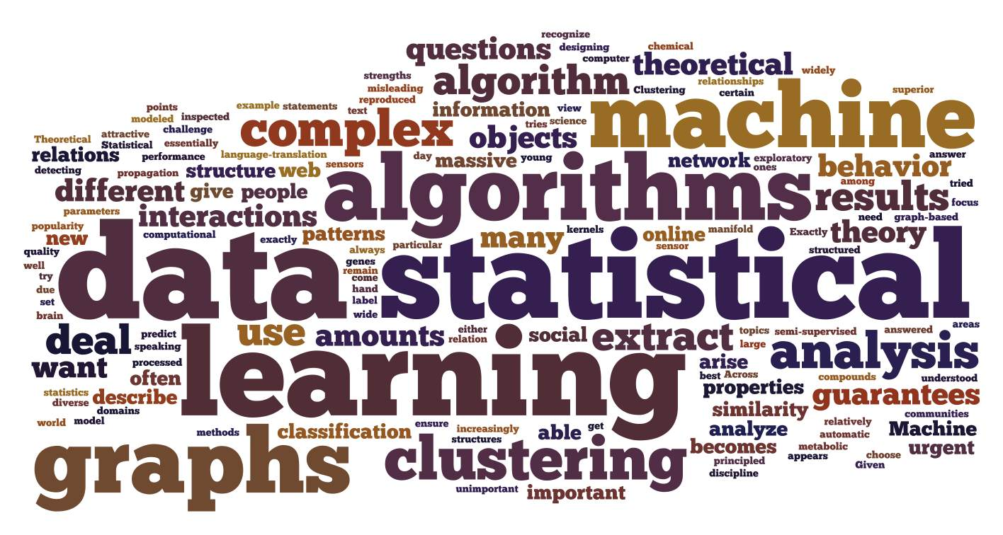
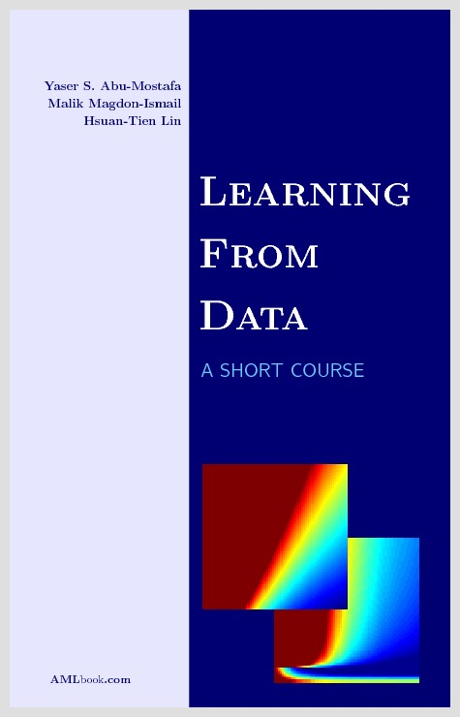

Machine Learning Jungle
Notation, paradigms, techniques, models, assumptions….
Every book does it differently.

Slide 5

Movie Ratings
902010 | Flying Sharks | Tom Cruise | …
10 | 10 | 0
902010 | Flying Sharks | Tom Cruise | …
10 | 10 | 0

Slide 6
Netflix Competition
 | User 1 | User 2 | Johan | …
Movie 1
Movie 2
Sharknado | ? | 1 1/1/2012 | 5 1/2/2013
…
Netflix Matrix
10% Improvement
1.000.000$ Prize
Notes:
netflix are lazy and believers in big data, data mining, machine learning.

Slide 7
When to learn
There is a pattern
You do not know the pattern
You have data
Notes:
Not random functions, not arbitrary functions
If i know then i do not need to learn it
I need something to learn from.

Slide 8
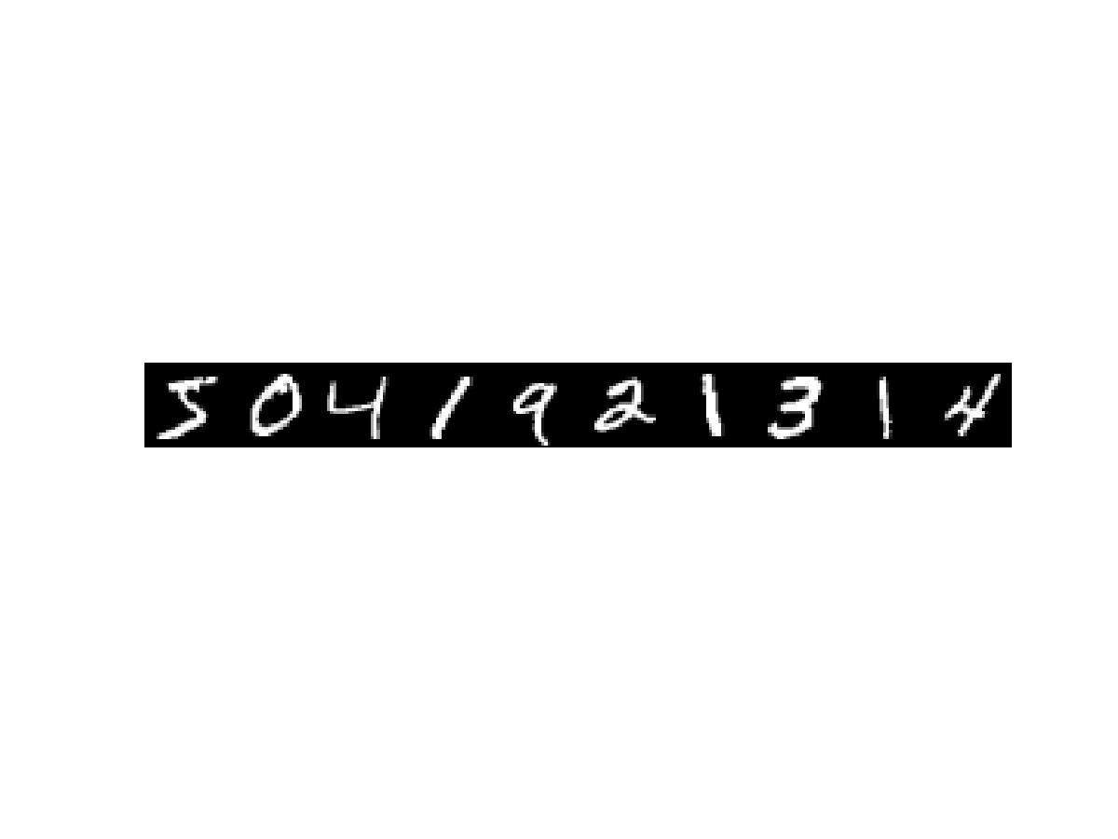

Supervised Learning
Learning From Examples
5 0 4 1 9 2 1 3 1 4
Data is list of example, target pairs
Learn mapping from examples to targets
that generalize to new unseen data
?
Notes:
Predict stock market tomorrow from stock market today.
Label mails spam based on million other spam and non spam messages.
Predict price of a house from historical records on house sales based on size, area, etc.
Grade students in machine learning based on their grade in other courses.

Slide 9
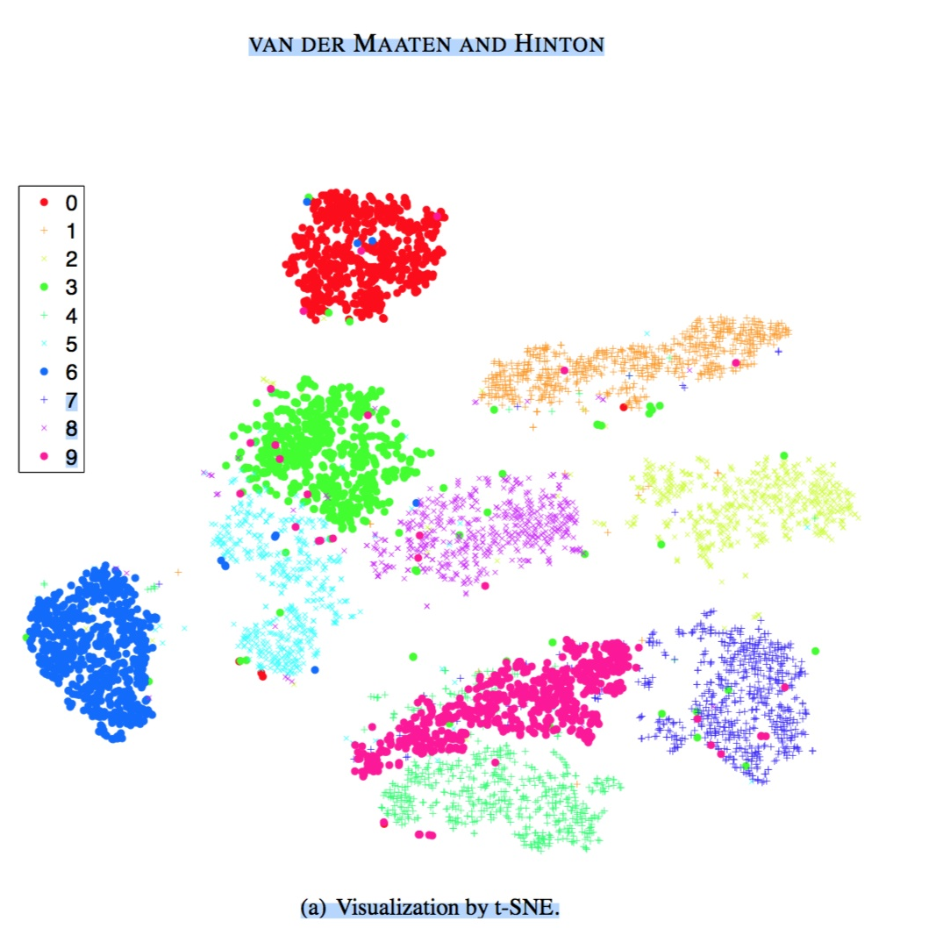
Unsupervised Learning
Learning About Data
Data is list of examples
Extract information about data
e.g. structure, patterns, anomalies.
Notes:
Preparing data for supervised learning, structure or probability distribution.
Dimensionality reduction. 28 x 28 to 2d, quite impressive.
Patterns about people buying beer are more likely to buy pretzels.
Finding anomalies, intruder detection or new trends or something like that.

Slide 10
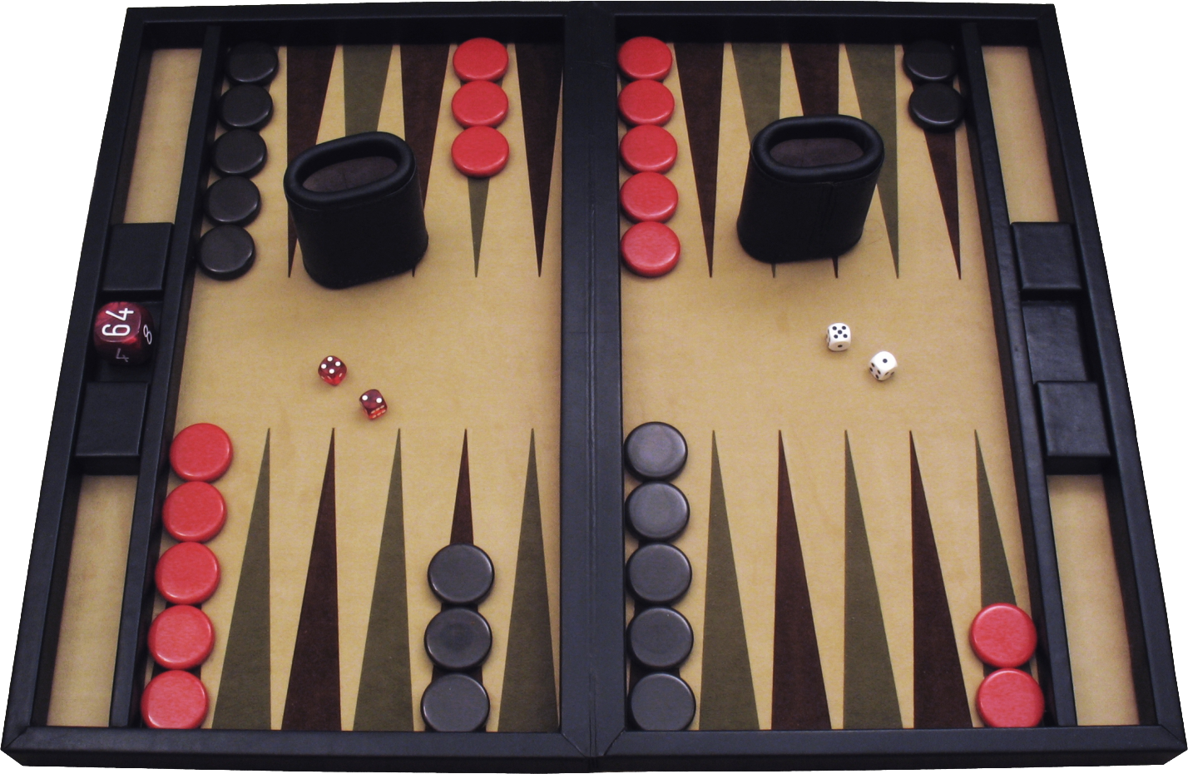
Reinforcement Learning
Learning By Doing
Data is (state, action, reward) triples
Optimize the rewards
Notes:
Agent, Enviroment
Kid getting burned
People who study. negative now payoff later.
Baby screaming to get parents attention so it can eat.

Slide 11
Approximate Course Plan
1
2
3
4
5
6
7
8
9
10
11
12
13
14
Linear Models
Convex Optimization
Learning Theory
VC dimension
Bias Variance
Regularization/Validation
Neural Nets,
SVMs, Kernels,
RBF
Hidden Markov Models
(Storm, Mailund)
Boosting/Aggregation
Clustering, Outlier Detection
(Assent)
Markov Decision Process,
Backgammon…
Supervised Learning
Unsupervised Learning
Reinforcement Learning

Slide 12
Today
Linear Classification – Perceptron
Linear Regression
Nonlinear Transforms

Slide 13
Supervised Learning Setup
Target Y:
Features/Predictors (Inputs) X
Unknown pattern
Data
Learn (from Data) a hypothesis that mimics target on new unknown data
Generalization is king
Notes:
Seems impossible and it is in the general case.

Slide 14

Overview
Unknown Target
Data Set
Learning Algorithm
Hypothesis h
h(x) ≈ f(x)
Hypothesis Set
This Week
Notes:
Leap of faith that this is actually sensible.
Formalize with error measure. and what we need to assume to to make learning possible
Next week we will elaborate on this a lot.
Hypothesis set is not a restriction, error measure must be formalized.

Slide 15

Example Wine Classification
Alcohol | 14.23
Ash | 2.43
Malic Acid | 1.71
Alcalinity of ash | 15.6
Magnesium | 127
Total Phenols | 2.8
Flavanoids | 3.06
Nonflavanoid Phenols | .28
Proanthocyanins | 2.29
Color Intensity | 5.64
Hue | 1.04
OD280/OD315 of diluted wines | 3.92
Proline | 1065
Chemical Analysis of wines from
different producers.
Learn to distinguish producers
from measurements.
Data is list of measurements, producer
pairs
Notes:
You already saw the digits example. Now for something completely different.
Your job is to come up with hypothesis set and learning algorithm.

Slide 16
Linear Classification (2 Classes)
x₁ | x₂ | … | x_{d} | y
 |  |  |  | 1
 |  |  |  | -1
 |  |  |  | 1
x₀ | x₁ | x₂ | … | x_{d} | y
1 |  |  |  |  | 1
1 |  |  |  |  | -1
…
1
IF
Return +1
Else Return -1
sign(w^{T}x)
Hypothesis set:
Learn good hypothesis, w, from data
Given new point x – Classify as
sign(w^{T}x)
Notes:
2D example
Leap of faith

Slide 17
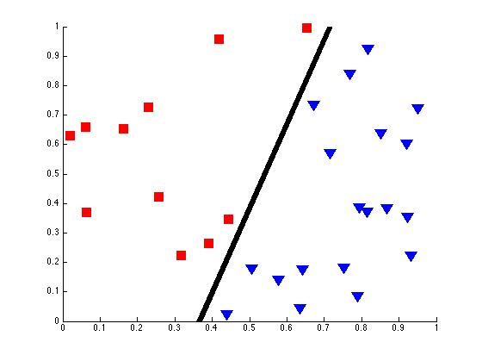
Simplified Example 2D
Hyperplane
Halfspace < 0
Halfspace >0
w
Data Is Linear Separable!!!

Slide 18
Perceptron Algorithm
Assume Data Is Linear Separable!!!
Theorem:
If data linear separable the perceptron algorithm finds a separating hyperplane.
Notes:
Switch to matlab and show how it works.
Read argument for convergence.
Consider adding pocket algorithm update.
running time is function of margin and magnitude of input points.
Describe the data set generation and so on.

Slide 19
Perceptron Summary
If data linear separable, perceptron converges
If not it never stops
Does not converge toward
Optimizing that is np-hard
Running time is function of data (exercise 1.3 in book)

Slide 20
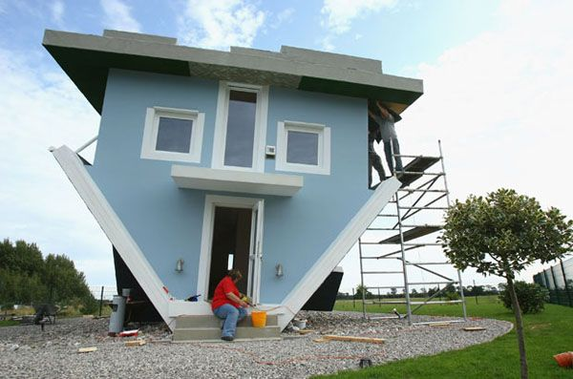
Pricing Houses
Size | 145
Property | 666
Rooms | 42
Levels | 10
House Age | 7
Bathrooms | 1
... | …
Historical data of real estate market
Learn to price houses from property info
Data is list of house info, sales price pairs
Notes:
Make into prediction house prices.
So i have a regression problem.

Slide 21
Linear Regression
x₀ | x₁ | x₂ | … | x_{d} | y
1 | 6 | 6 |  | 6 | 42
1 | 3 | 3 |  | 3 | 33
…
1 | 2 | 3 | 4 | 5 | 6
Learn good hypothesis, w, from data
Given new point x – Output estimate
Notes:
Already included the bias variable

Slide 22
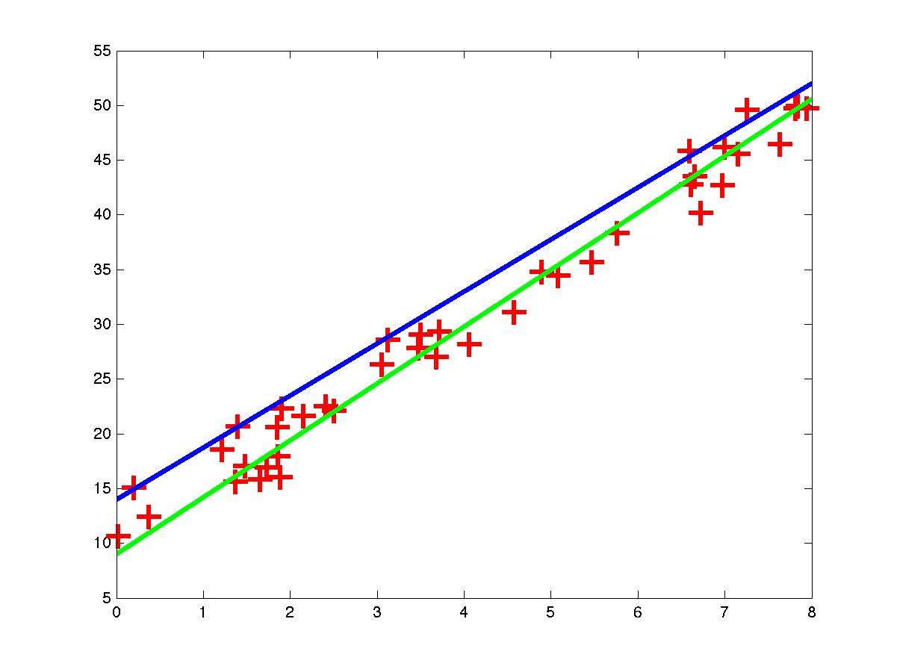
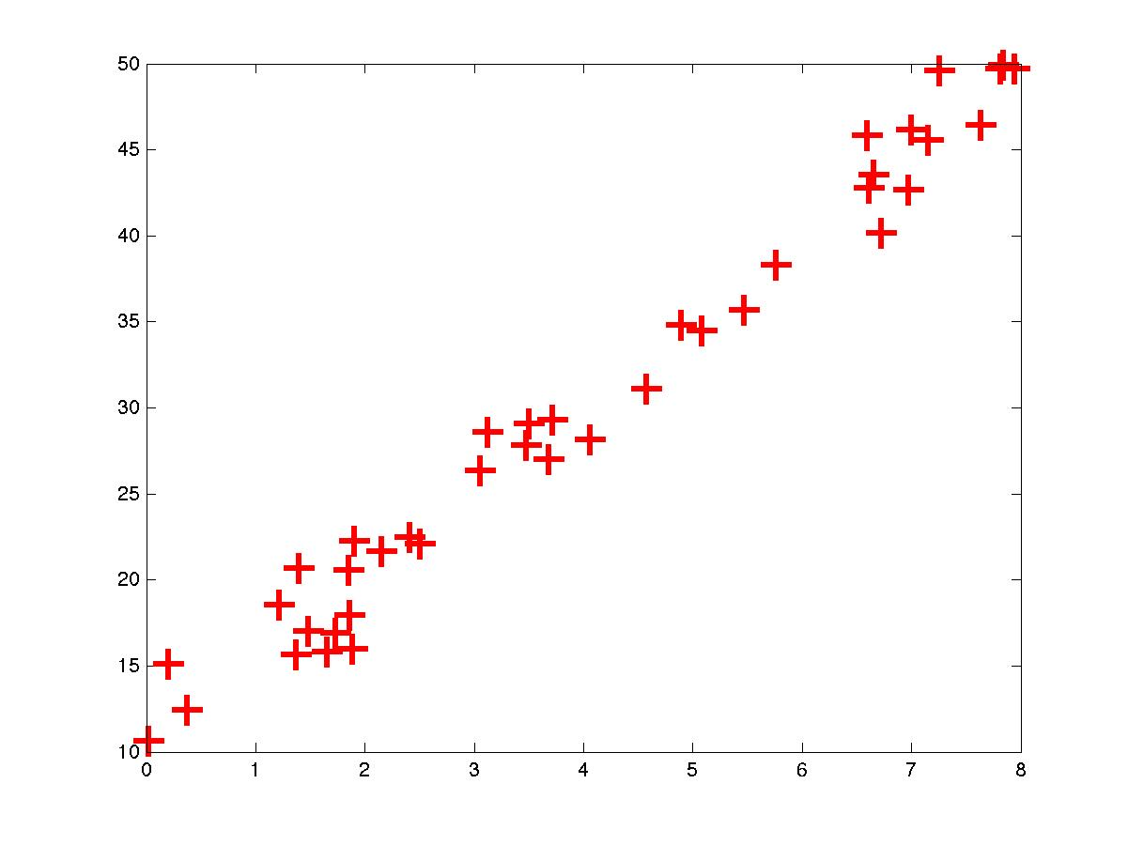
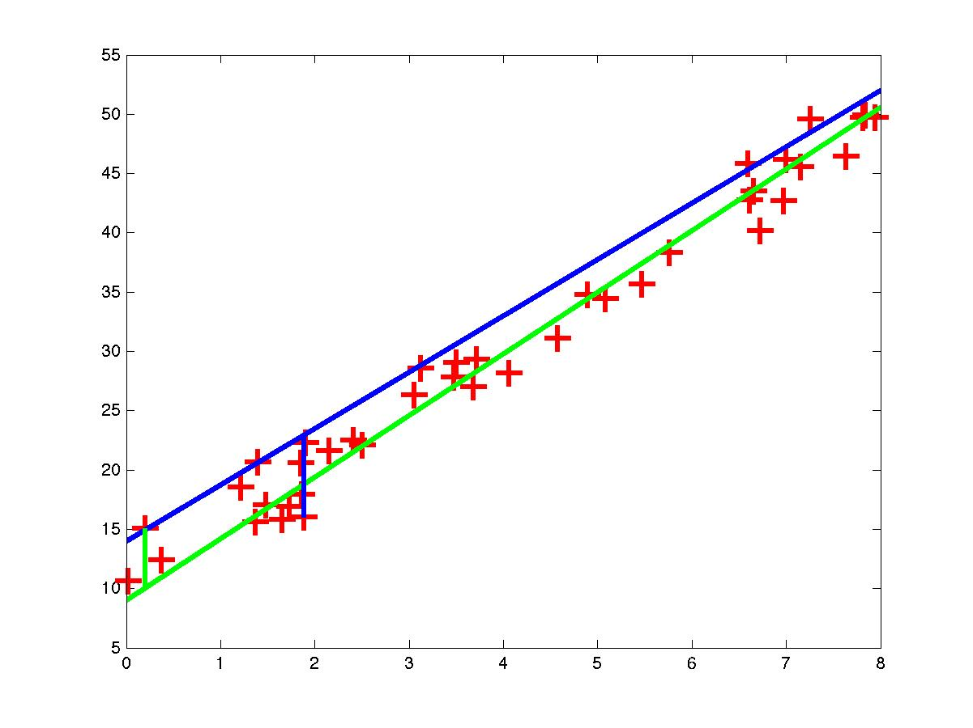
2D Example (Predict y From x)

Slide 23
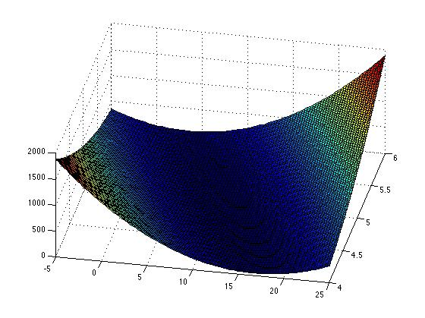
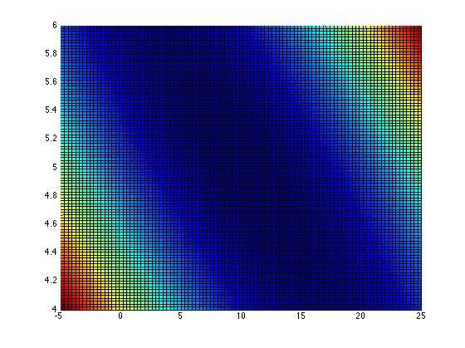
Contour Plot of 2D Error Surface
Line is determined by 2 parameters. So i can plot the error . Color encodes value
Looks easy enough…

Slide 24
Finding Minimum – A Reminder
Local minimum is global minimum in our case
since E is convex (next time)
Notes:
Since E is convex

Slide 25
Data Representation
n x (d+1) matrix
each row is an input point
n x 1 column
vector,
each row is
input target
(d+1) x 1
column
vector

Slide 26
Error Measure Manipulation
Picture of error measure

Slide 27
Gradient For Linear Regression (L2)
Solve for 0:
Notes:
Think of w^T (X^TX)w as taking derivaties of a square.
Take it slow. Tedious math.

Slide 28
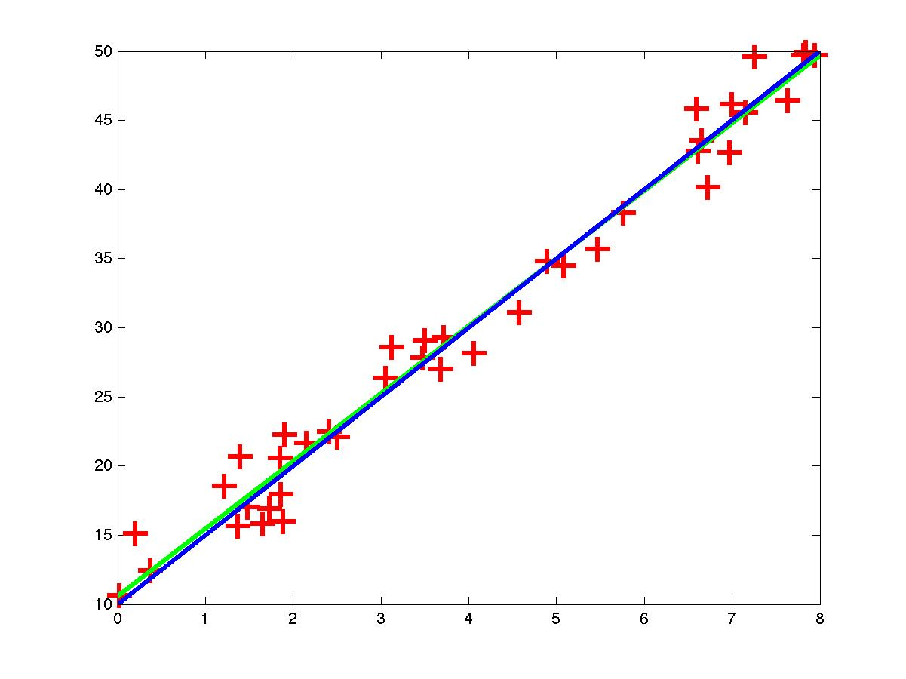
Result

Slide 29
Summary Linear Regression

Slide 30
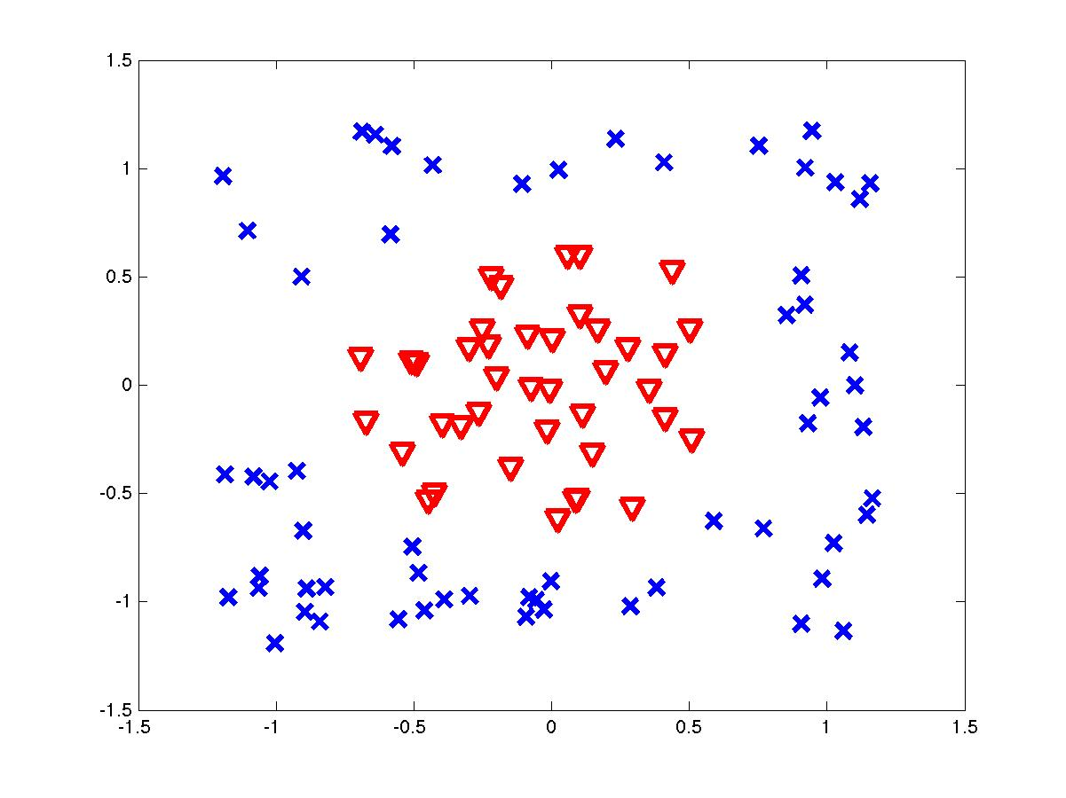
Nonlinear Transformations
?
Linear in w
Still Linear in w

Slide 31
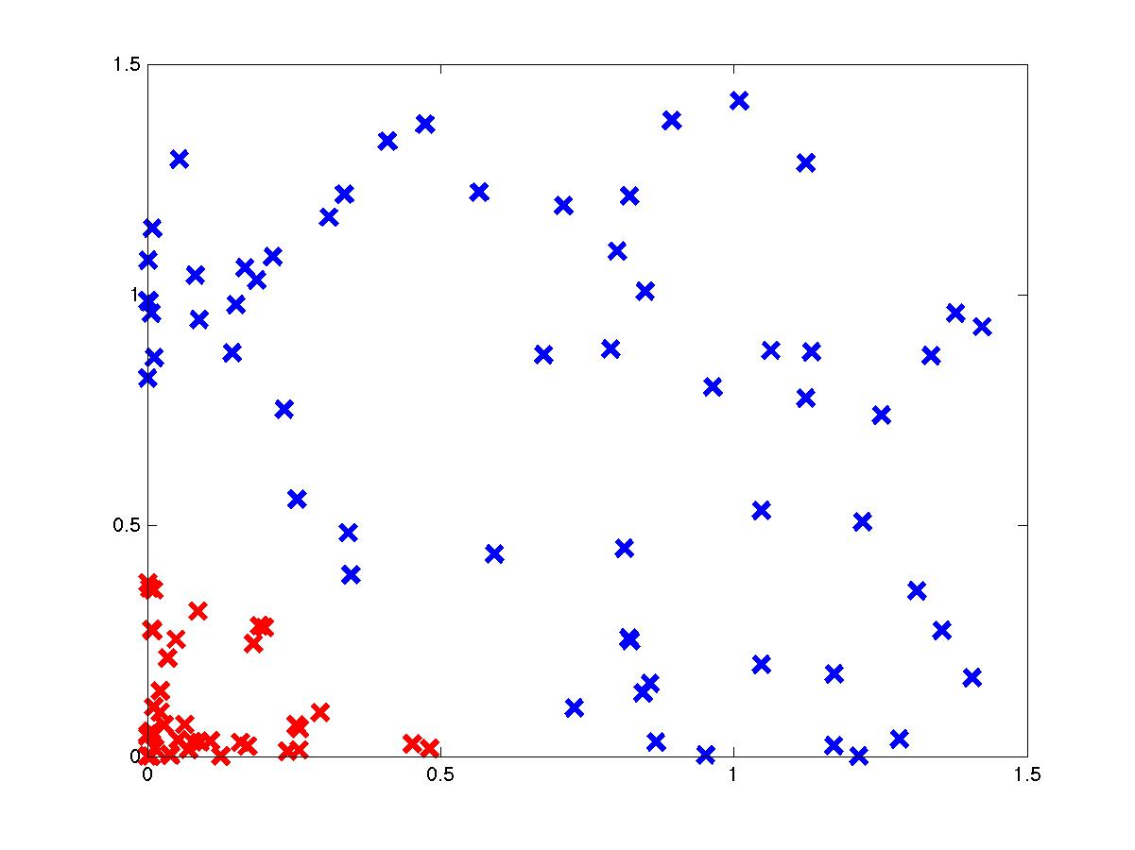
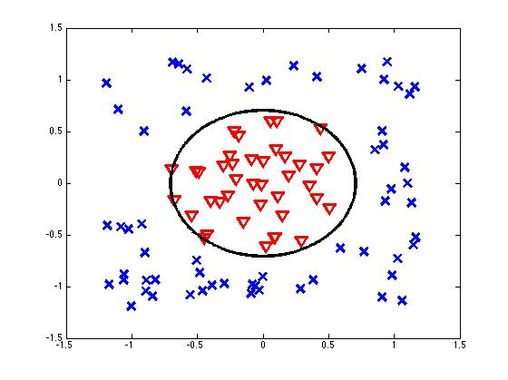
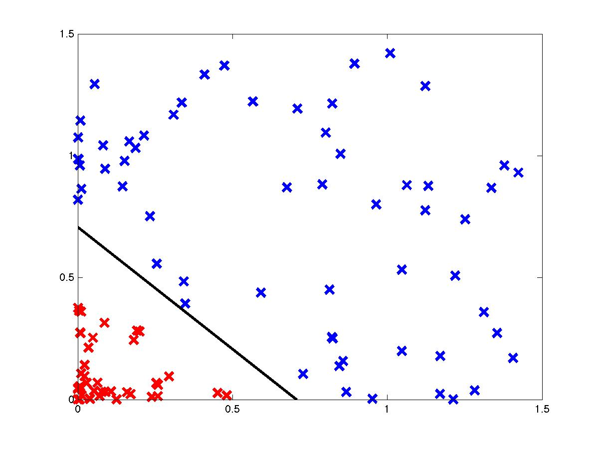
Making Data Linear Separable

Slide 32
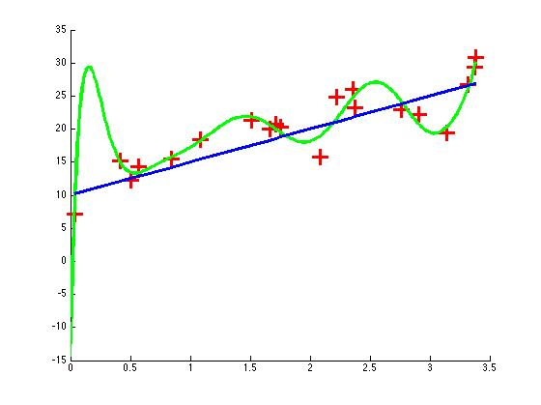
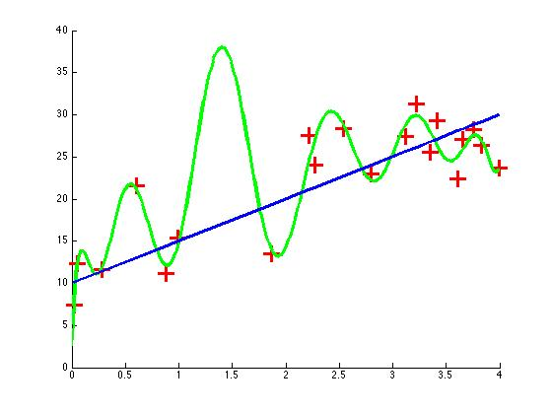
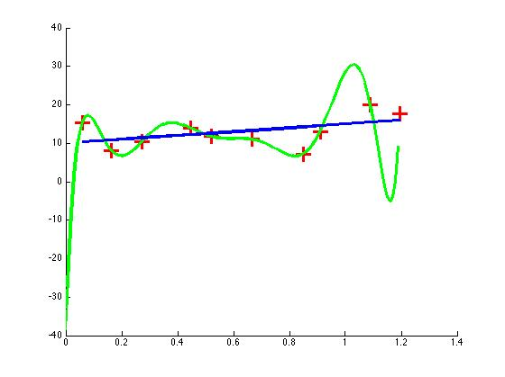
Overfitting

